Slide 1

SLap lesions
Tyler Kent, M.D.

Slide 2
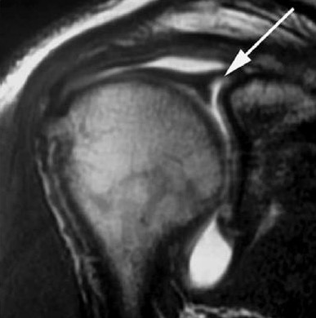
Introduction
Case Study
Anatomy
Pathophysiology
Classification
Biomechanics
Diagnosis
Treatment

Slide 3
Case study
JZ 42m Deputy Sheriff
Hammer punch during training, felt pop and pain
Tackled, landed on same shoulder
Had numbness, pain, decreased ROM and strength

Slide 4
JZ, Physical exam
No edema or ecchymosis, NV intact
Equal and full ROM, except internal rotation (T12 vs T10)
Anterior apprehension
5/5 strength except 5- and pain in supraspinatus
Scapular droop

Slide 5
JZ, MRI
MRI Arthrogram (Images not available)
Type II SLAP tear extending from the 11:00 to 3:00 positions
Moderate Subscapularis tendinosis
No fractures or cuff tears
He failed conservative therapy and elected to undergo surgery

Slide 6
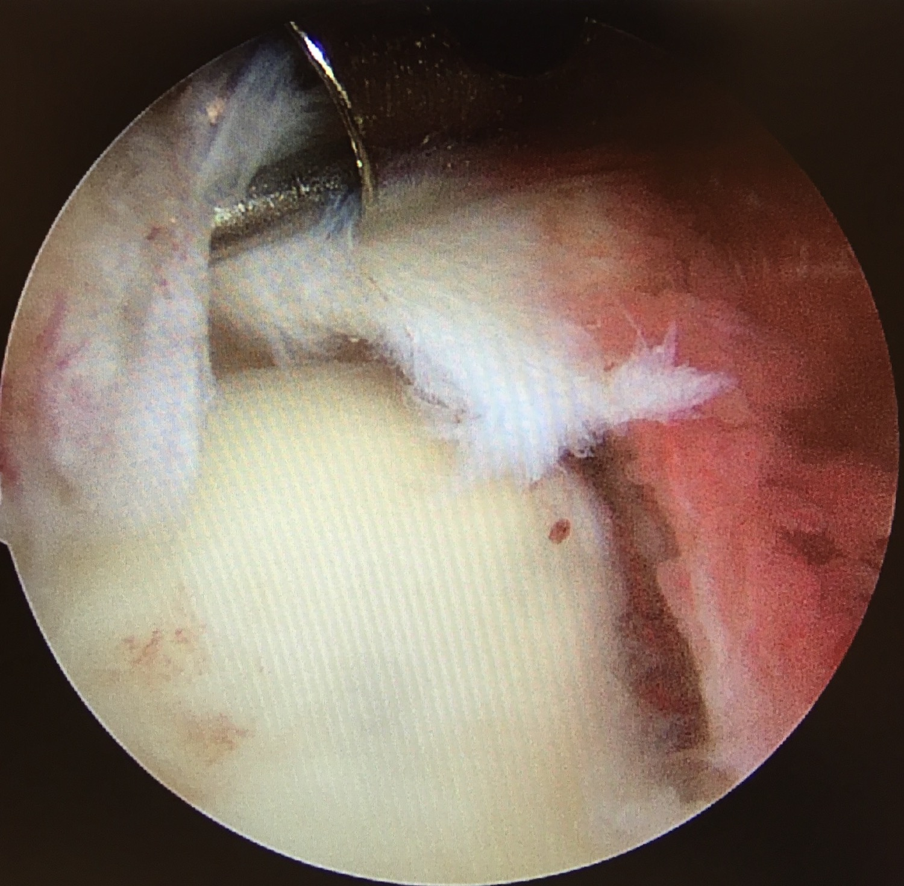
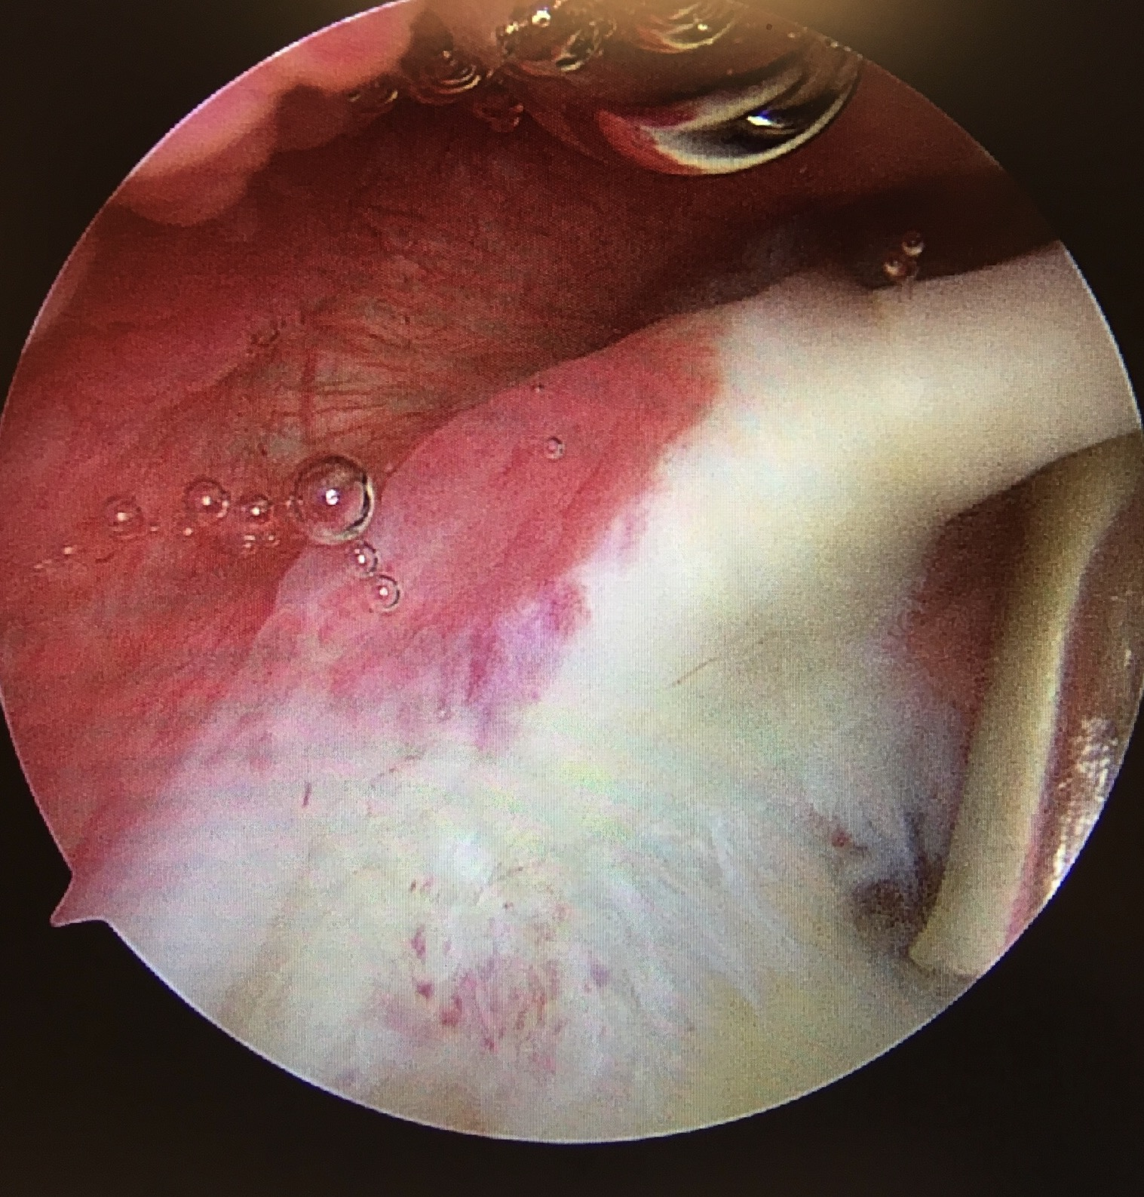
Jz, intra-op slap tear

Slide 7
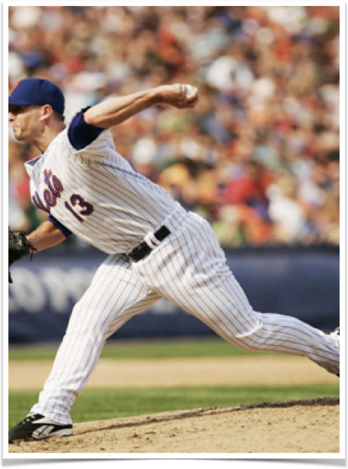
1938 Bankart describes injury to anteroinferior labrum
1985 Andrews describes superior glenoid injuries
1990 Snyder defines "slap" lesions and proposes classification system
History and background

Slide 8
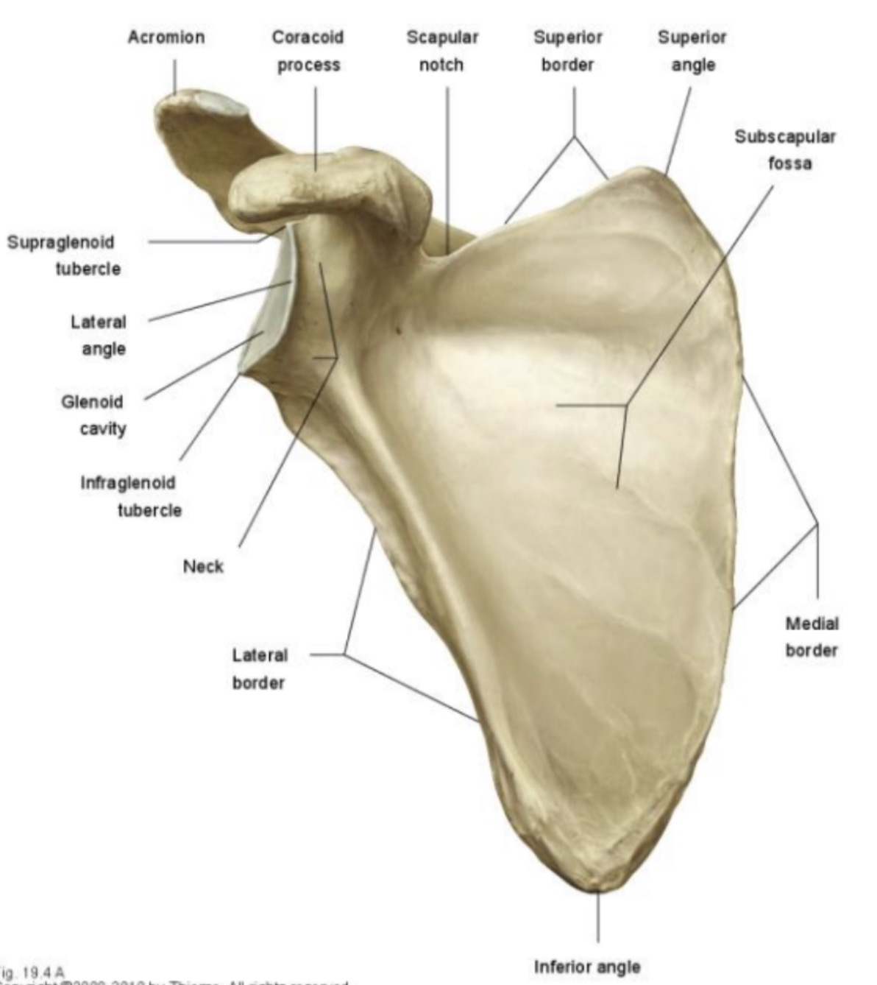
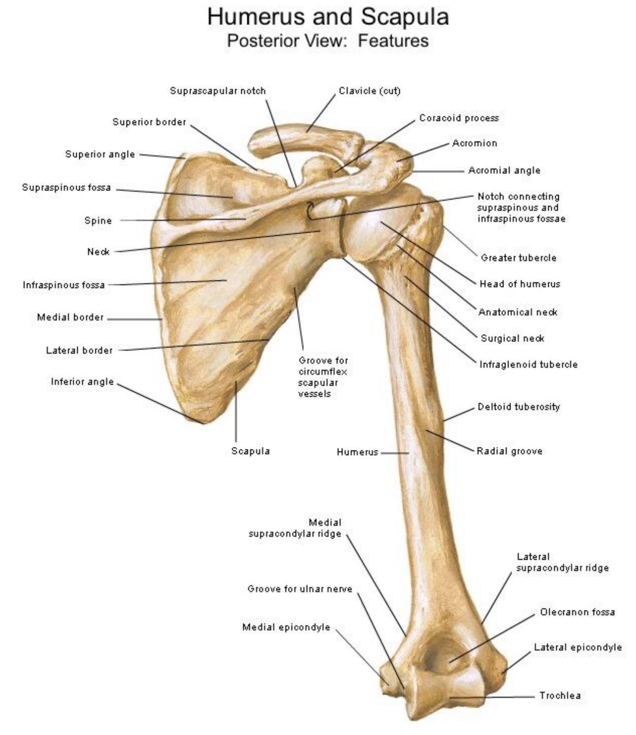
Osteology

Slide 9
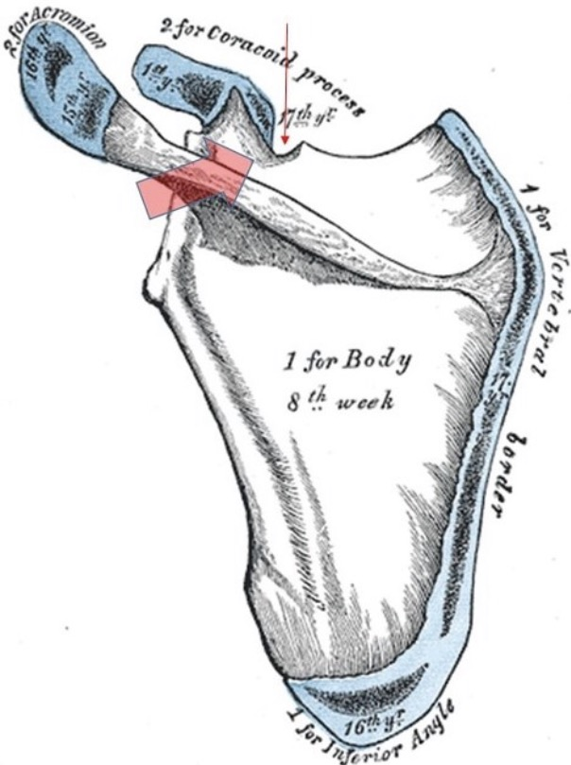
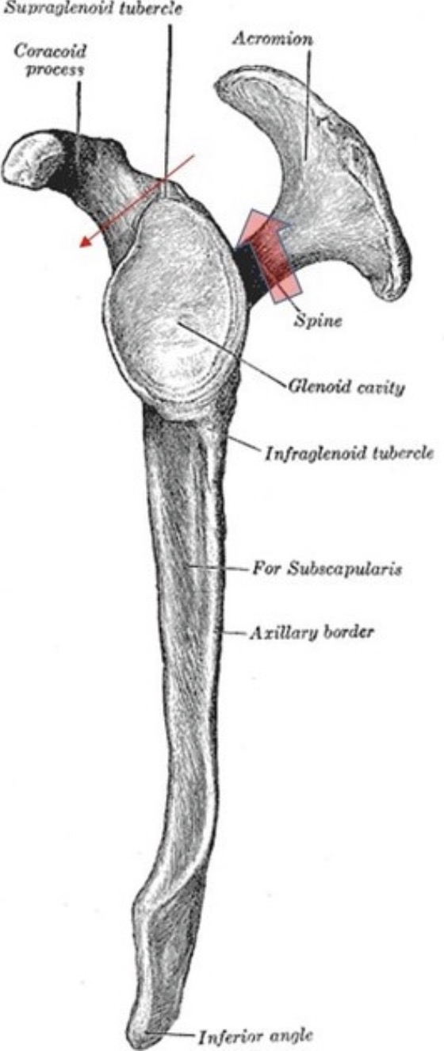
Spinoglenoid and suprascapular notches

Slide 10
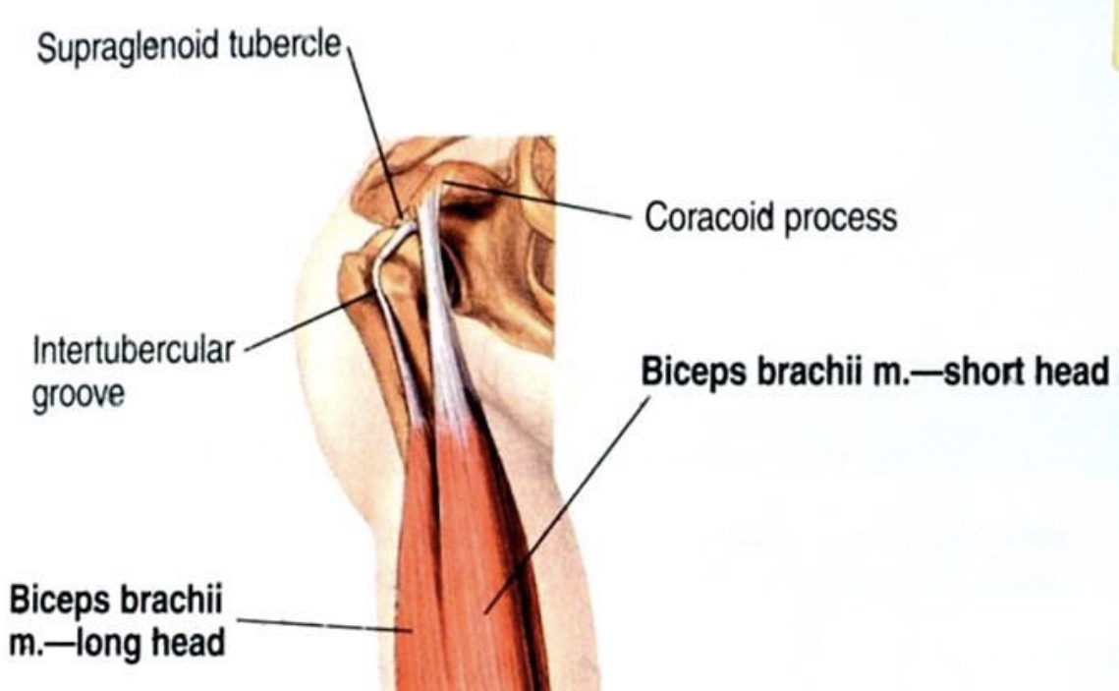
Supraglenoid tubercle
40-60% of long head biceps origin
Medial insertion site of superior labrum

Slide 11
Labral structure
Primarily fibrous
Very little elastin
Fibrocartilagenous transition point to glenoid

Slide 12
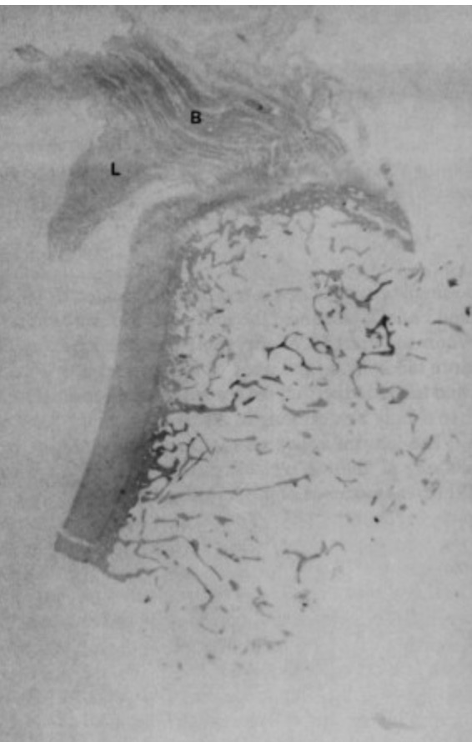
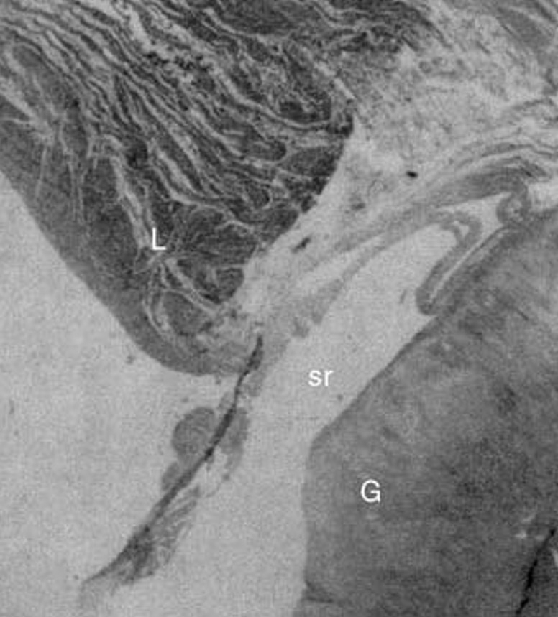
Histology
Parallel, circumferential collagen
Fibrocartilagenous zone borders glenoid hyaline cartilage
Synovial recess
LHB partially inserts onto labrum

Slide 13
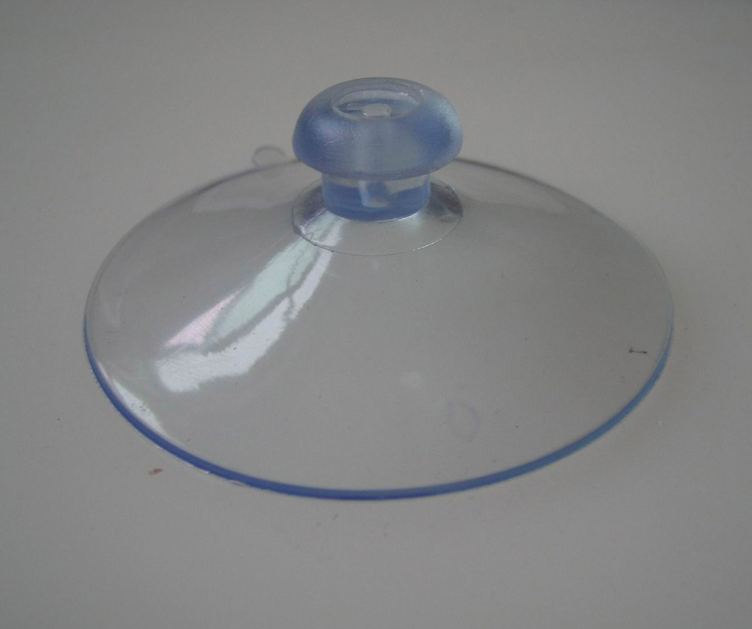
Labral functions
Augments concavity of glenoid
Increases diameter of glenoid
Provides negative pressure
Attachment site for glenohumeral ligaments

Slide 14
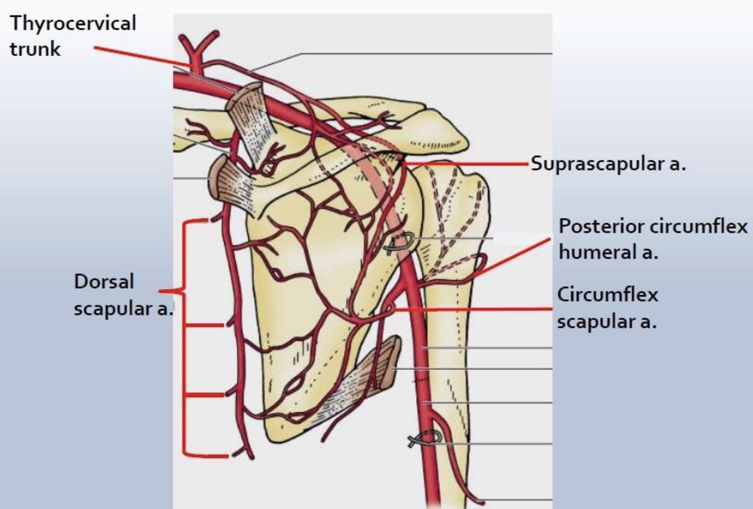
Labral blood supply
Suprascapular artery
Subscapular Circumflex artery
Circumflex humeral arteries (posterior>anterior)
Inner portion is avascular
Anterosup < Inferopost

Slide 15
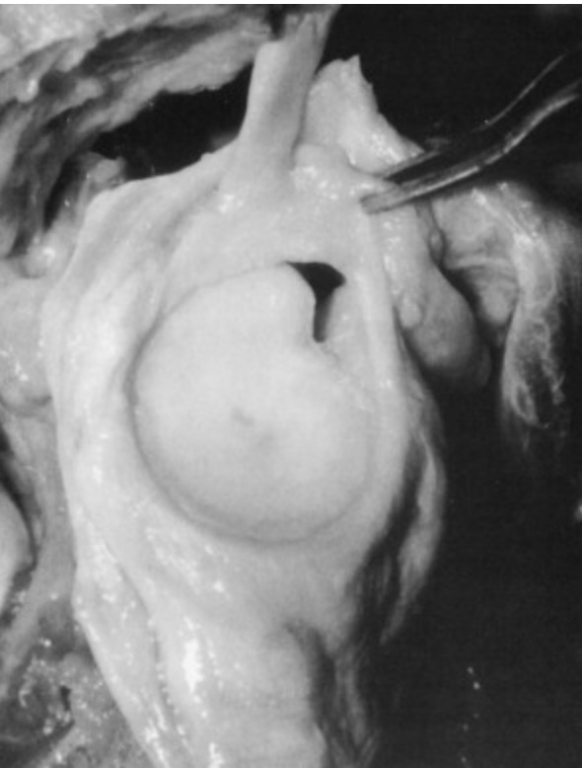
Labral variations
Prevalence of ~13%
Meniscoid labrum
Sublabral foramen
Sublabral foramen with cordlike middle glenohumeral ligament
Absent anterosuperior labrum with cordlike middle glenohumeral ligament (Buford Complex)
AAOS Comprehensive Ortho Review 2, 2014

Slide 16
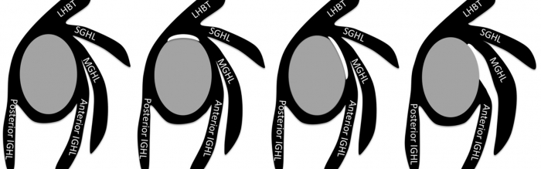
Labral variations

Slide 17
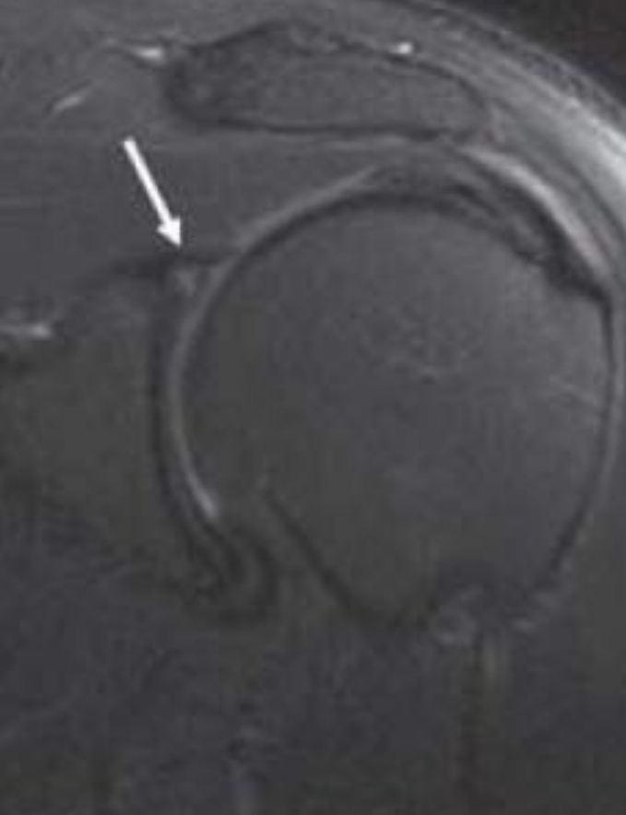
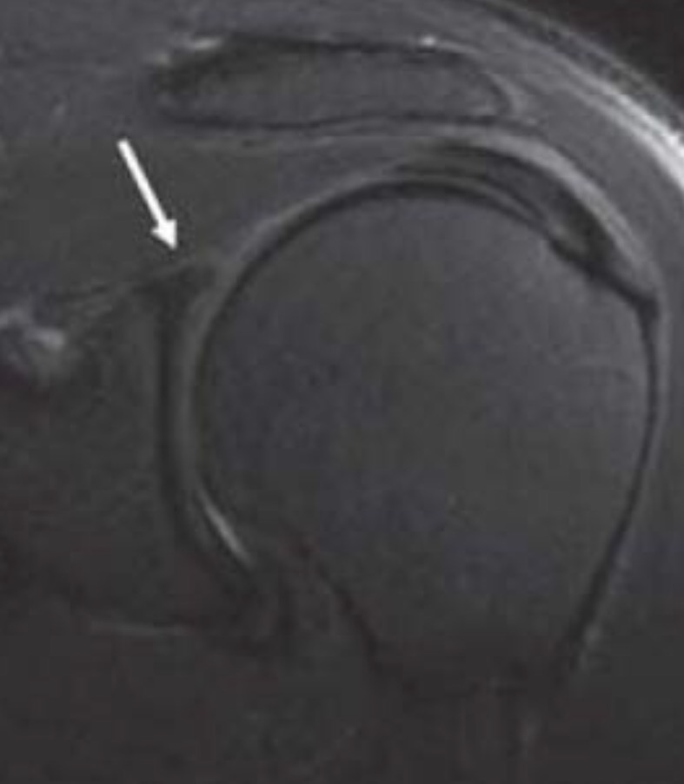
Meniscoid labrum

Slide 18
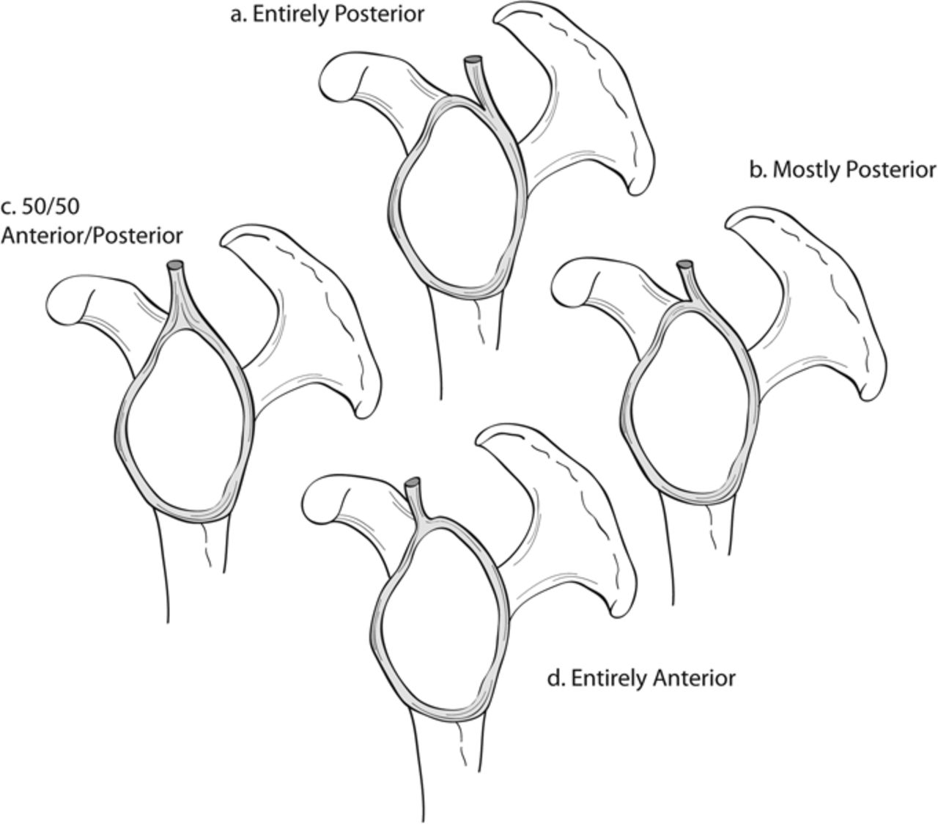
Biceps orientation & function
Typically posterior
Static humeral head depressor (2` stabilizer to ant/post translation in abd/ER
Proper tension improves torsional rigidity in abd/ER
Overconstraint = stiffness

Slide 19
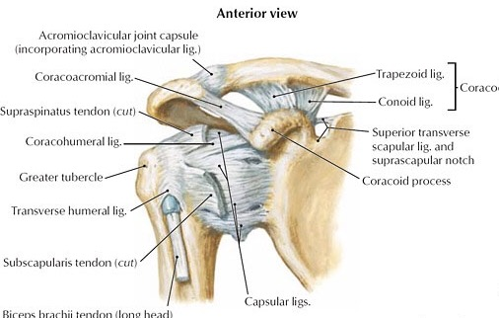
Biceps sling
Intertubercular groove
Subscapularis tendon
Supraspinatus tendon
Coracohumeral ligament
Superior glenohumeral ligament
Ascending anterior humeral circumflex artery

Slide 20
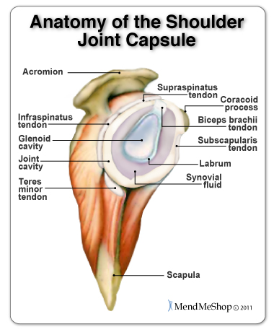
Tendons/rotator cuff
Biceps
Supraspinatus
Infraspinatus
Teres minor
Subscapularis

Slide 21
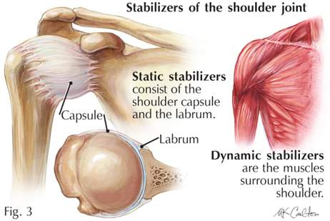
Shoulder stabilizers
Rotator cuff
Biceps
Glenohumeral ligaments
Capsule
Labrum

Slide 22
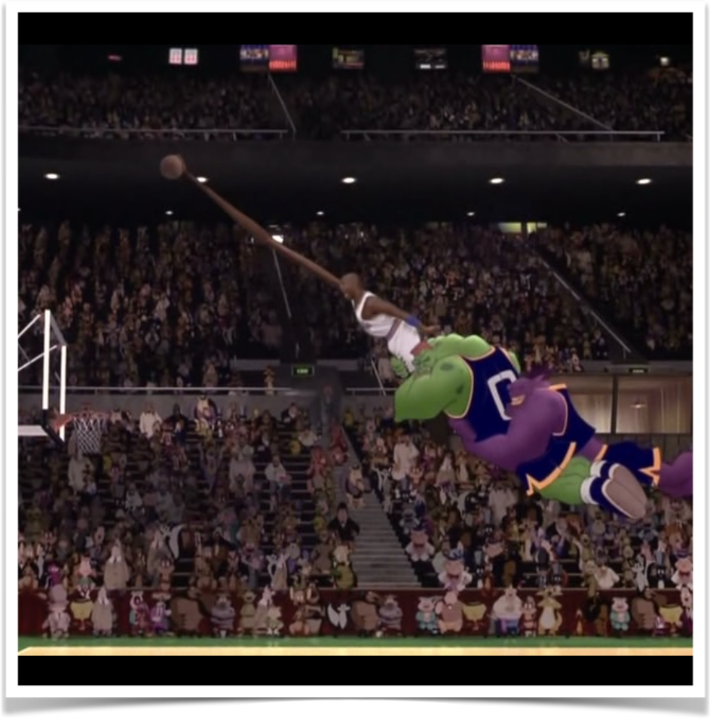
Pathogenesis
Forceful traction
Direct compression/impingement
"Peel back"
Repetitive, overhead activities
Subluxation or dislocation

Slide 23
Pathogenesis
Burkhart et al. (1998) described a cascade. ABD/ER normally causes posteroinferior migration of humeral head
Throwing/overhead activity causes lengthening of anterior capsuloligamentous restraints and posterior capsular contracture
ABD/ER leads to posterosuperior migration of humeral head
Allows hyperexternal rotation
Leads to increased torsional forces at the biceps root

Slide 24
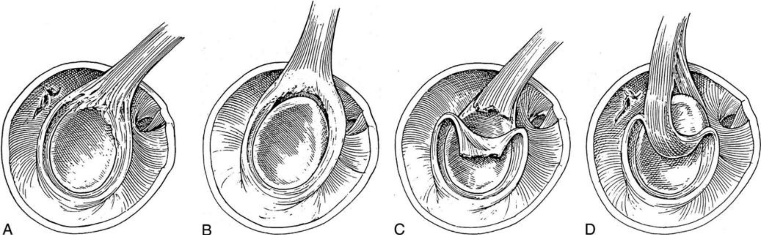
Snyder classification

Slide 25
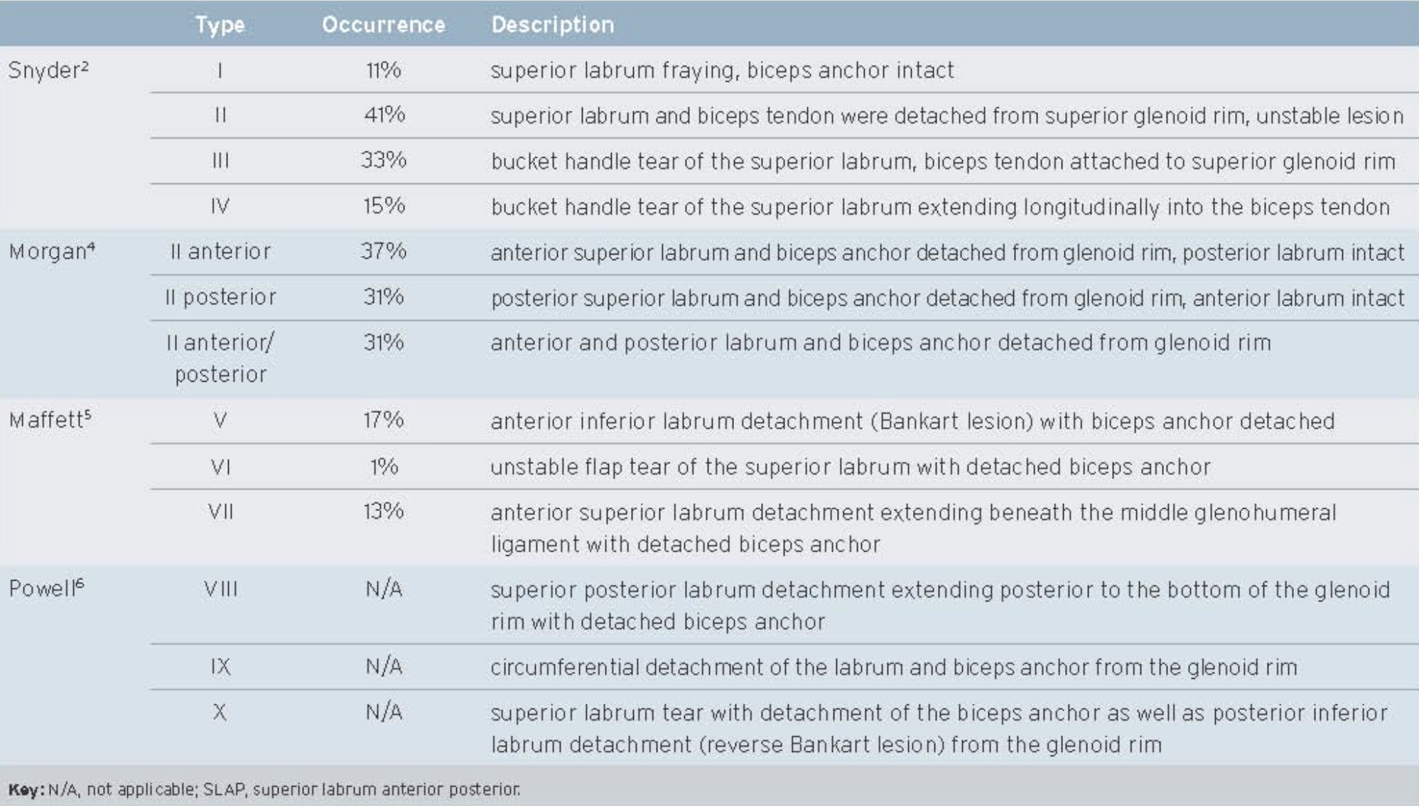
Modified snyder
Powers, JAAPA Mar. 2011

Slide 26
Clinical presentation
Variable presentation
Often coexisting pathology
Deep pain, "dead arm"
Mechanical symptoms
AROM typically preserved
Weakness
Instability typically associated with other pathology

Slide 27
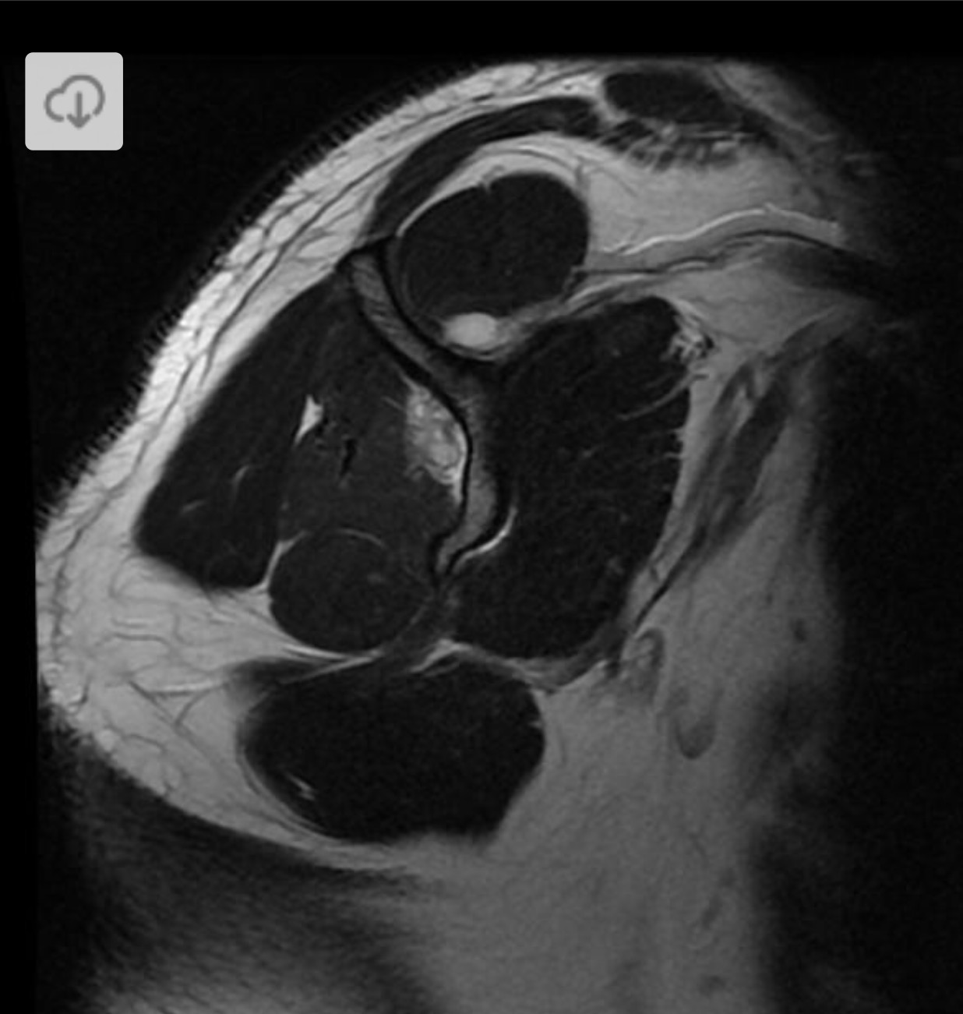
Paralabral ganglion and spinoglenoid notch cysts

Slide 28
Spinoglenoid and suprascapular notches

Slide 29
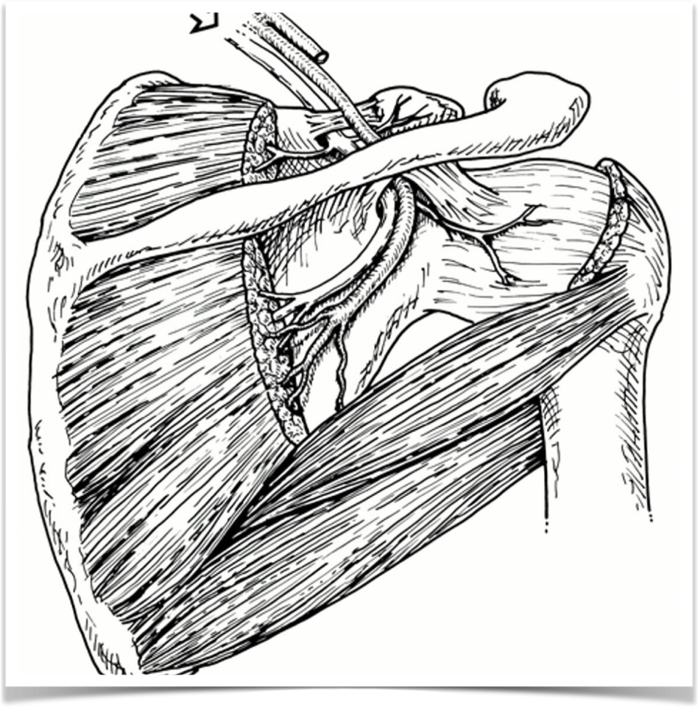
Suprascapular nerve
Branches off brachial plexus
Passes through suprascapular notch
Enters supraspinous fossa
Curves lateral around spine
Enters infraspinous fossa

Slide 30
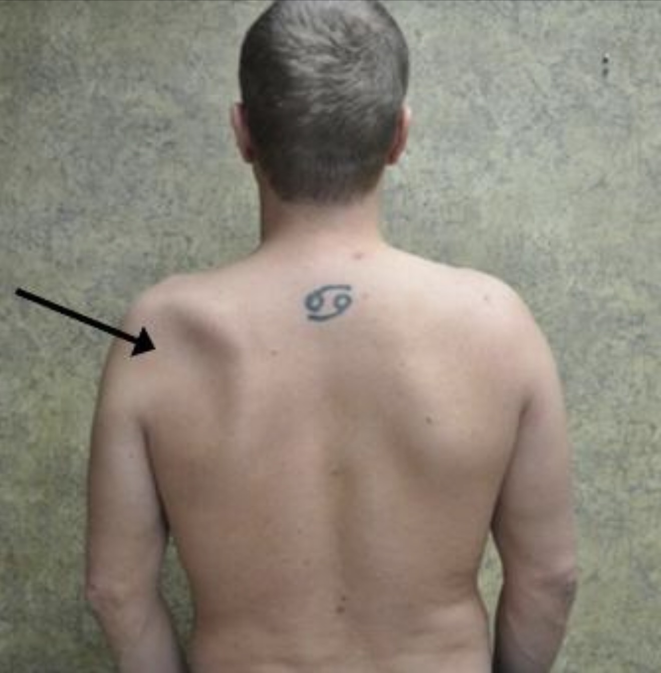
spinoglenoid notch cysts
Leads to infraspinatus weakness/atrophy

Slide 31
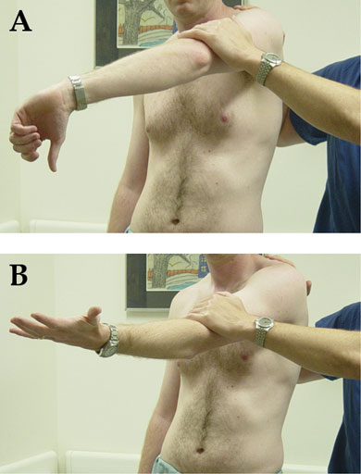
Provocative maneuvers
O'Brien Active Compression Test:
90 degrees forward flexion, 10 degrees adduction, pronation
Resist forward flexion
Repeat in supination
+ if no pain in supination

Slide 32
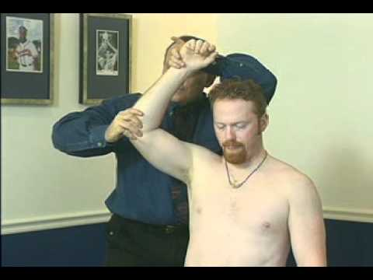
Provocative maneuvers
Crank Test:
Forward flex and abduct arm
Axial force, passive humeral internal and external rotation
+ if pain or mechanical symptoms

Slide 33
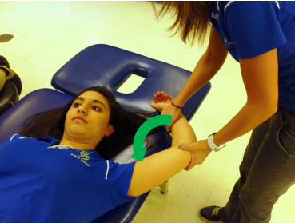
Provocative maneuvers
Biceps Load Test I and II:
ABD to 90 then 120, externally rotate, supination
Elbow flexion against resistance
+ if pain or apprehension

Slide 34
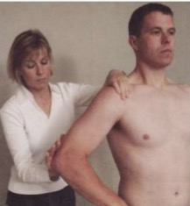
Provocative maneuvers
Anterior Slide Test:
Hand on hip, thumb posterior
Resist anterior force to elbow
+ if pain or mechanical symptoms

Slide 35
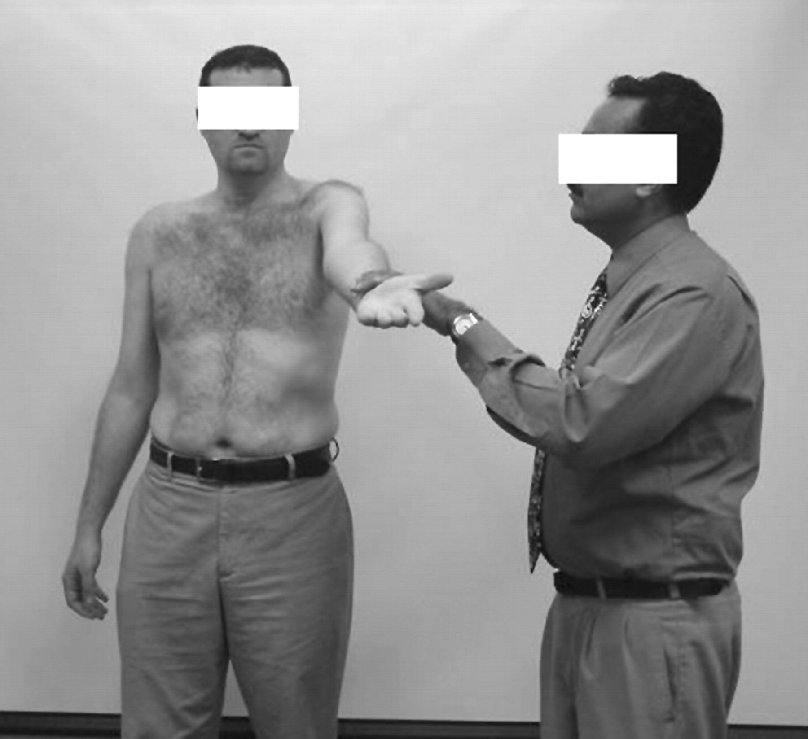
Provocative maneuvers
Speed Test:
90 degrees forward flexion, elbow extension, supination
Resist downward pressure
+ if pain in anterior shoulder

Slide 36
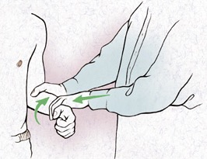
Provocative maneuvers
Yergason Test:
Adducted to side, elbow flexed to 90, pronation
Resisted supination

Slide 37
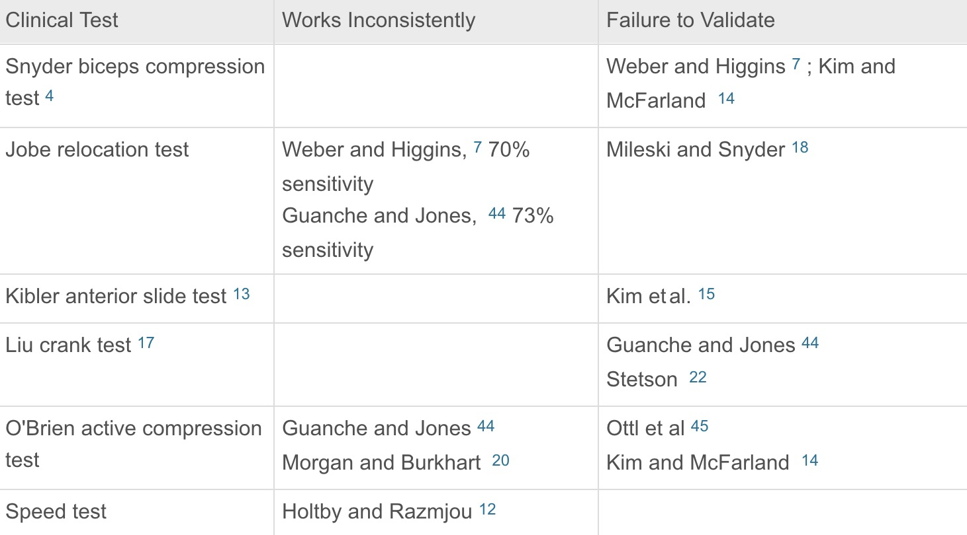
Conundrum
Weber, et al. 2014

Slide 38
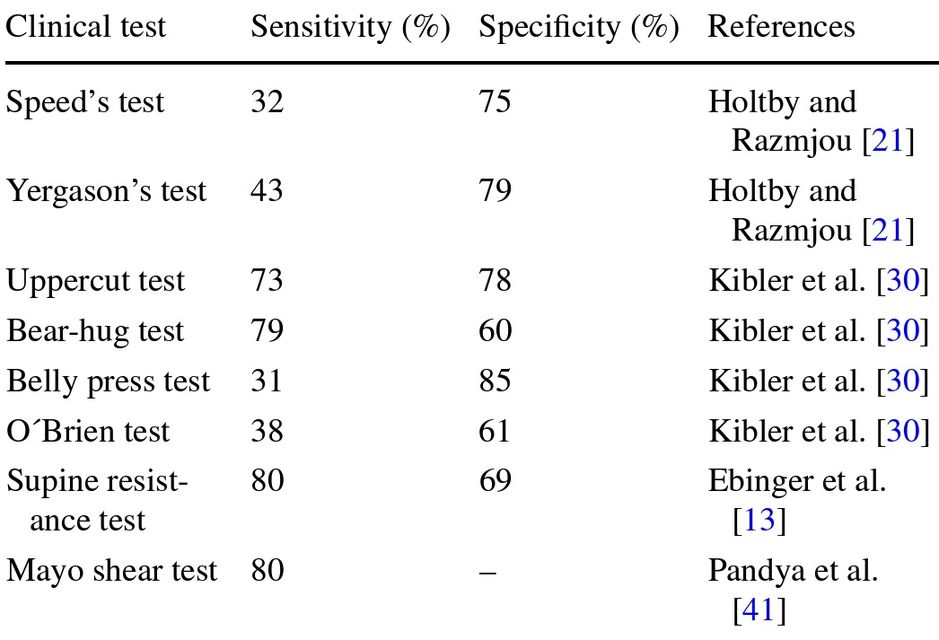
Conundrum
Brockmeyer et al. 2016

Slide 39
Diagnosis
AAOS recommends combining sensitive tests (i.e O'Brien and Crank) with specific tests (Speed)
Should perform complete exam (scapular fxn, cuff eval, neurovascular, etc)
Anesthetic injections into glenohumeral joint or bicipital groove
MRI. Sensitivity, specificity, and accuracy range from 84% to 98%, 63% to 91%, and 74% to 96%, respectively (Keener et al. 2009)
Arthroscopy

Slide 40
Treatment (Non-op)
Based on specific findings and goals
Capsular flexibility
Rotator Cuff
Scapular stabilizers
Corticosteroid injections

Slide 41
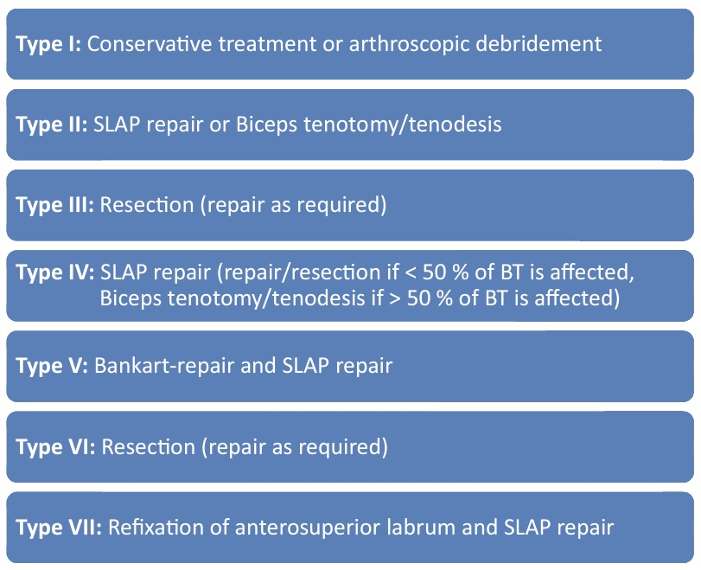
Treatment (Operative)
After failed conservative therapy, periods of rest, etc
Based on pathology
Brockmeyer et al. 2016
Notes:
It is unclear whether patients benefit from SLAP repair at all. Some studies suggest that people do better with a biceps tenotomy or tenodesis.

Slide 42
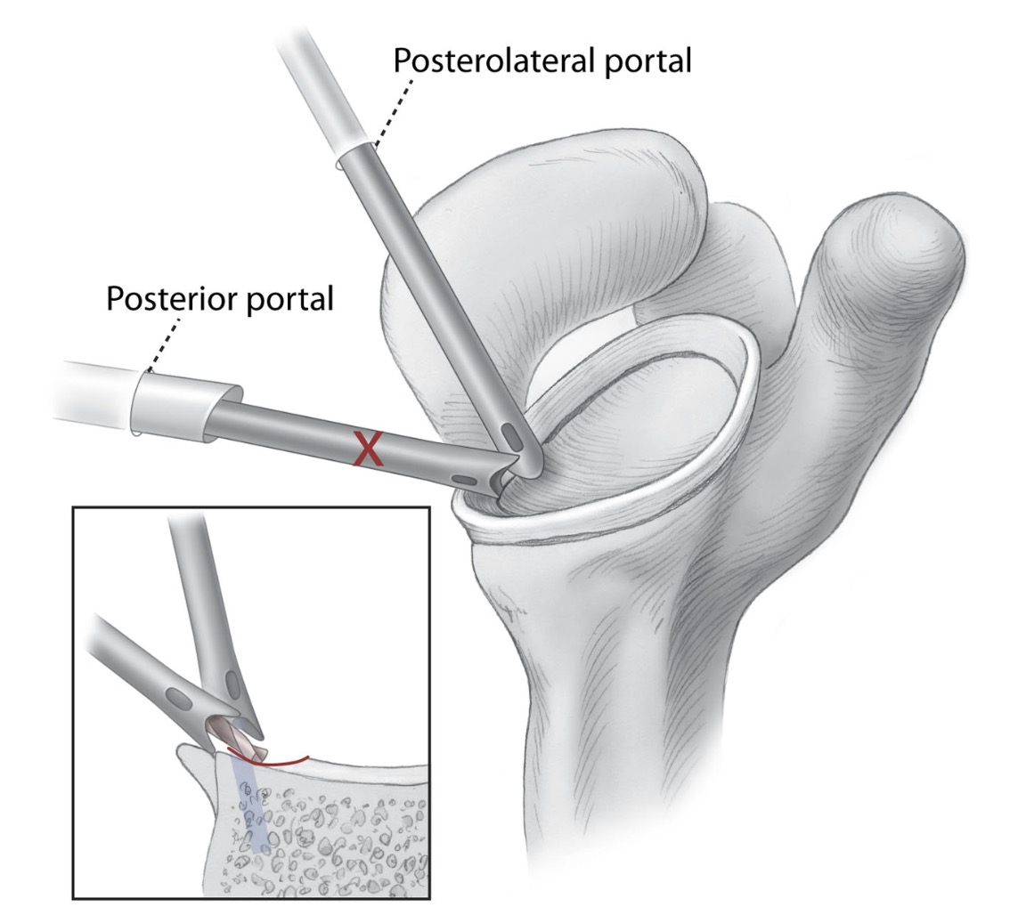
Treatment Techniques
Bioabsorbable tacks
Suture anchors
Knotless fixation

Slide 43
Treatment - Concomitant Pathology
Paralabral ganglion cysts
Subacromial bursitis
Rotator cuff tears - depend on age and activity level
Biceps tendinopathy

Slide 44
Treatment - biceps, indications
SLAP with biceps involvement > 25-50%
Subluxation or dislocation
Tenosynovitis/tendinitis

Slide 45
Treatment - Biceps, options
Tenotomy vs Tenodesis (Pulley/sling repairs ineffective)
Tenotomy: For sedentary, older/elderly patients; easy to perform
Tenodesis: For the active; pain generator; proximal vs distal to groove, suprapectoral vs subpectoral; retained painful tendon

Slide 46

Complications
Retear
Stiffness
Persistent pain
Rotator cuff tear
Biceps tenotomy: deformity, cramping, fatigue, loss of supination/flexion
Biceps tenodesis: rupture, pain (w/ prox tenodesis), humeral fracture
JZ developed capsular stiffness requiring release

Slide 47
Treatment trends
ABOS board cert database, 2002 --> 2011
8963 isolated SLAP repairs. 1540 RCR + SLAP
Isolated: SLAP repairs 69.3% to 44.8% (P < .0001), biceps tenodesis 1.9% to 18.8% (P < .0001), and biceps tenotomy 0.4% to 1.7% (P = .018)
RCR + SLAP: SLAP 60.2% to 15.3% (P < .0001), biceps tenodesis or tenotomy 6.0% to 28.0% (P < .0001)
significant difference in the mean age of patients undergoing SLAP repair (37.1 years) versus biceps tenodesis (47.2 years) versus biceps tenotomy (55.7 years) (P < .0001).
Patterson et al. 2014

Slide 48
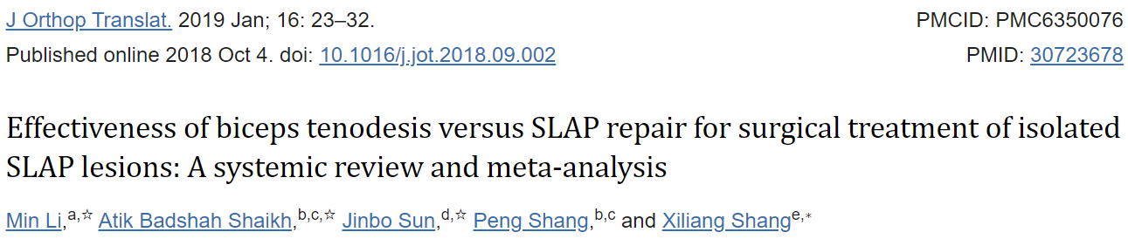
5 RCTs, 204 patients; SLAP repair vs tenodesis
Patient satisfaction and return to pre-injury level of sports is greater with tenodesis (p<0.05)
No sig differences in VAS, ASES, UCLA, stiffness, or reoperation

Slide 49
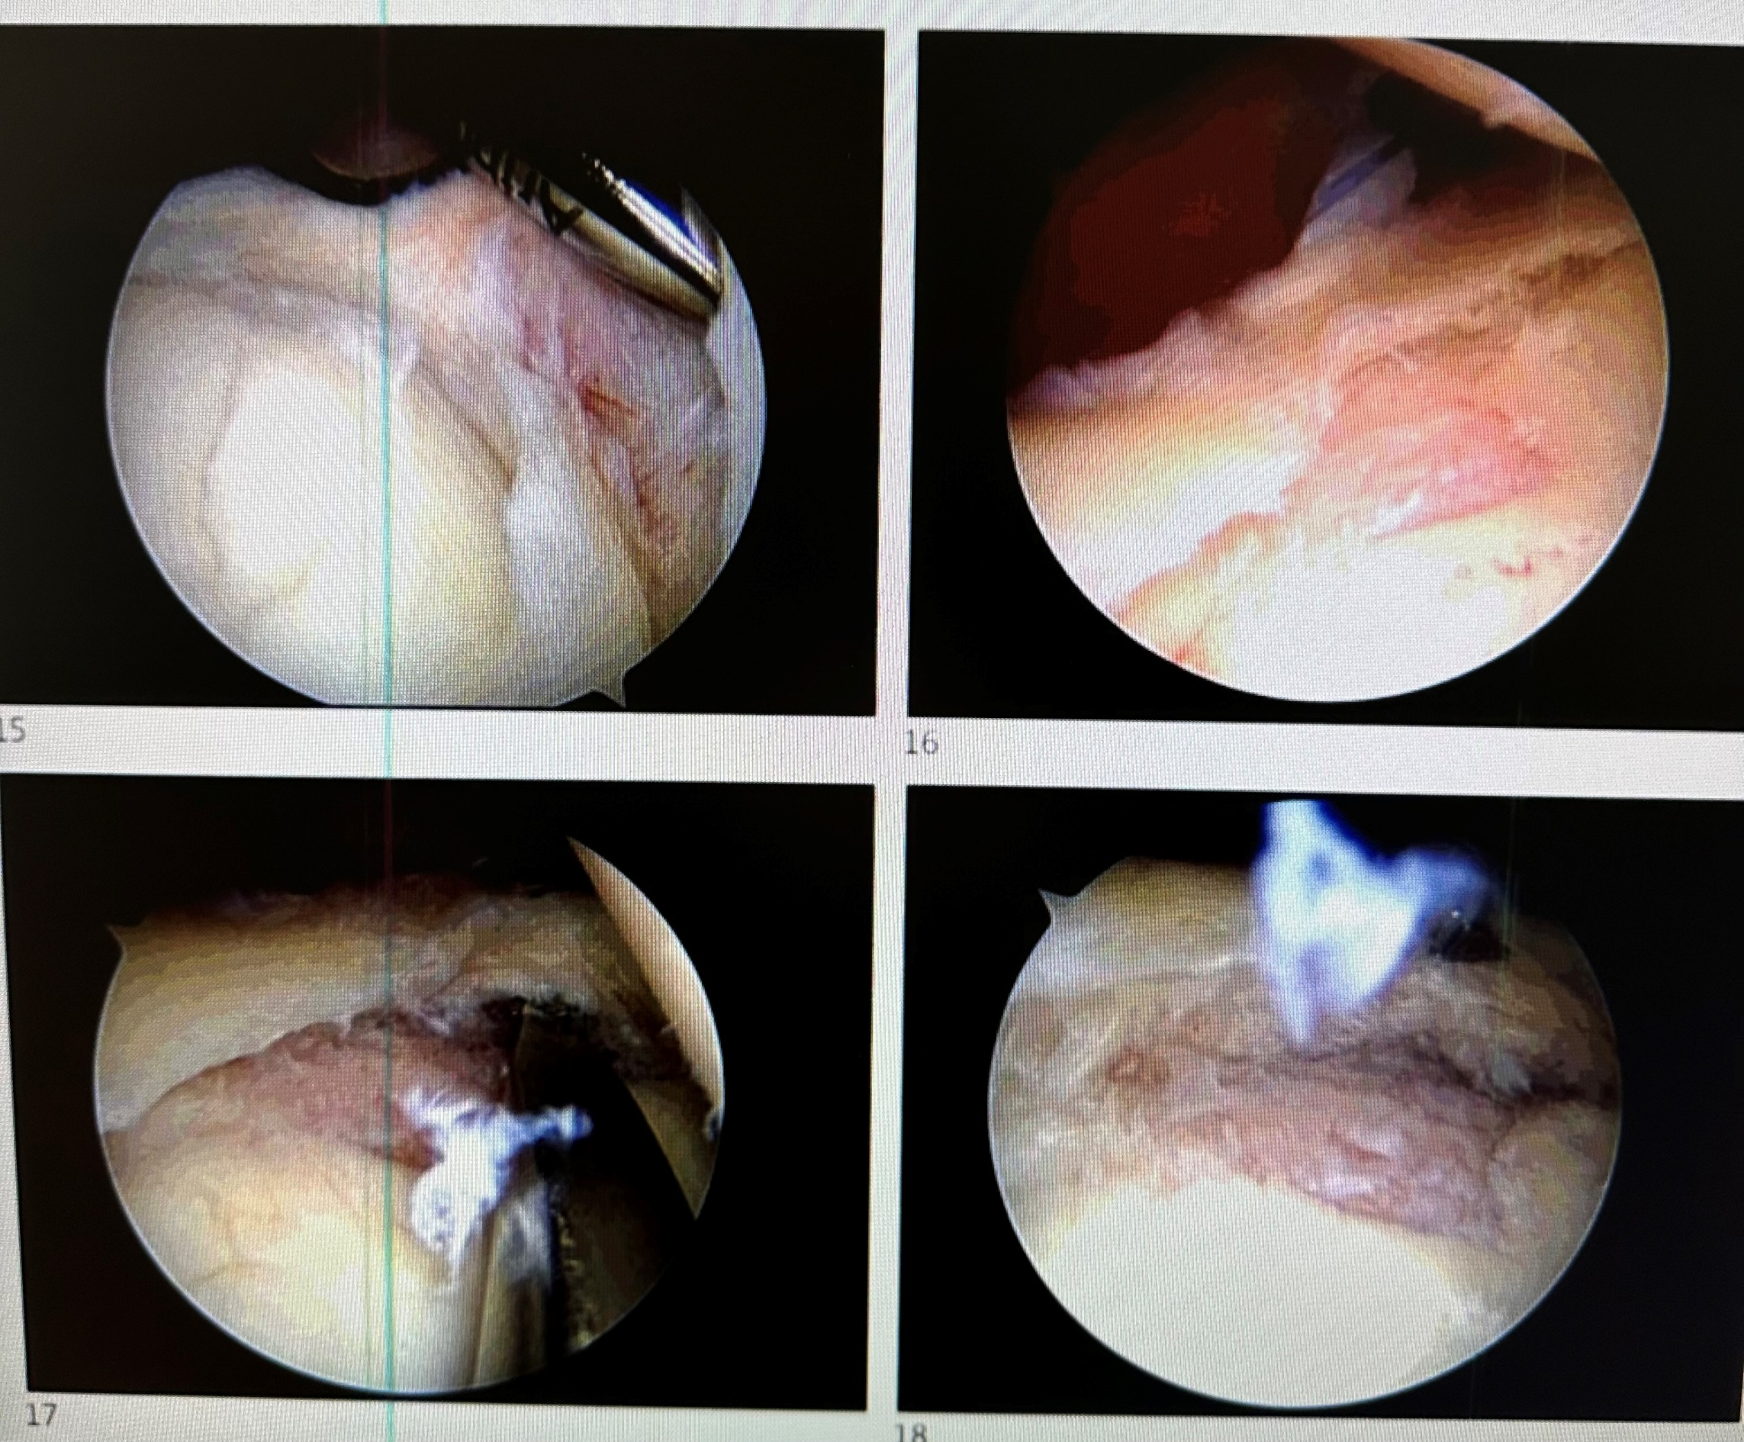
Isolated Slap repair

Slide 50
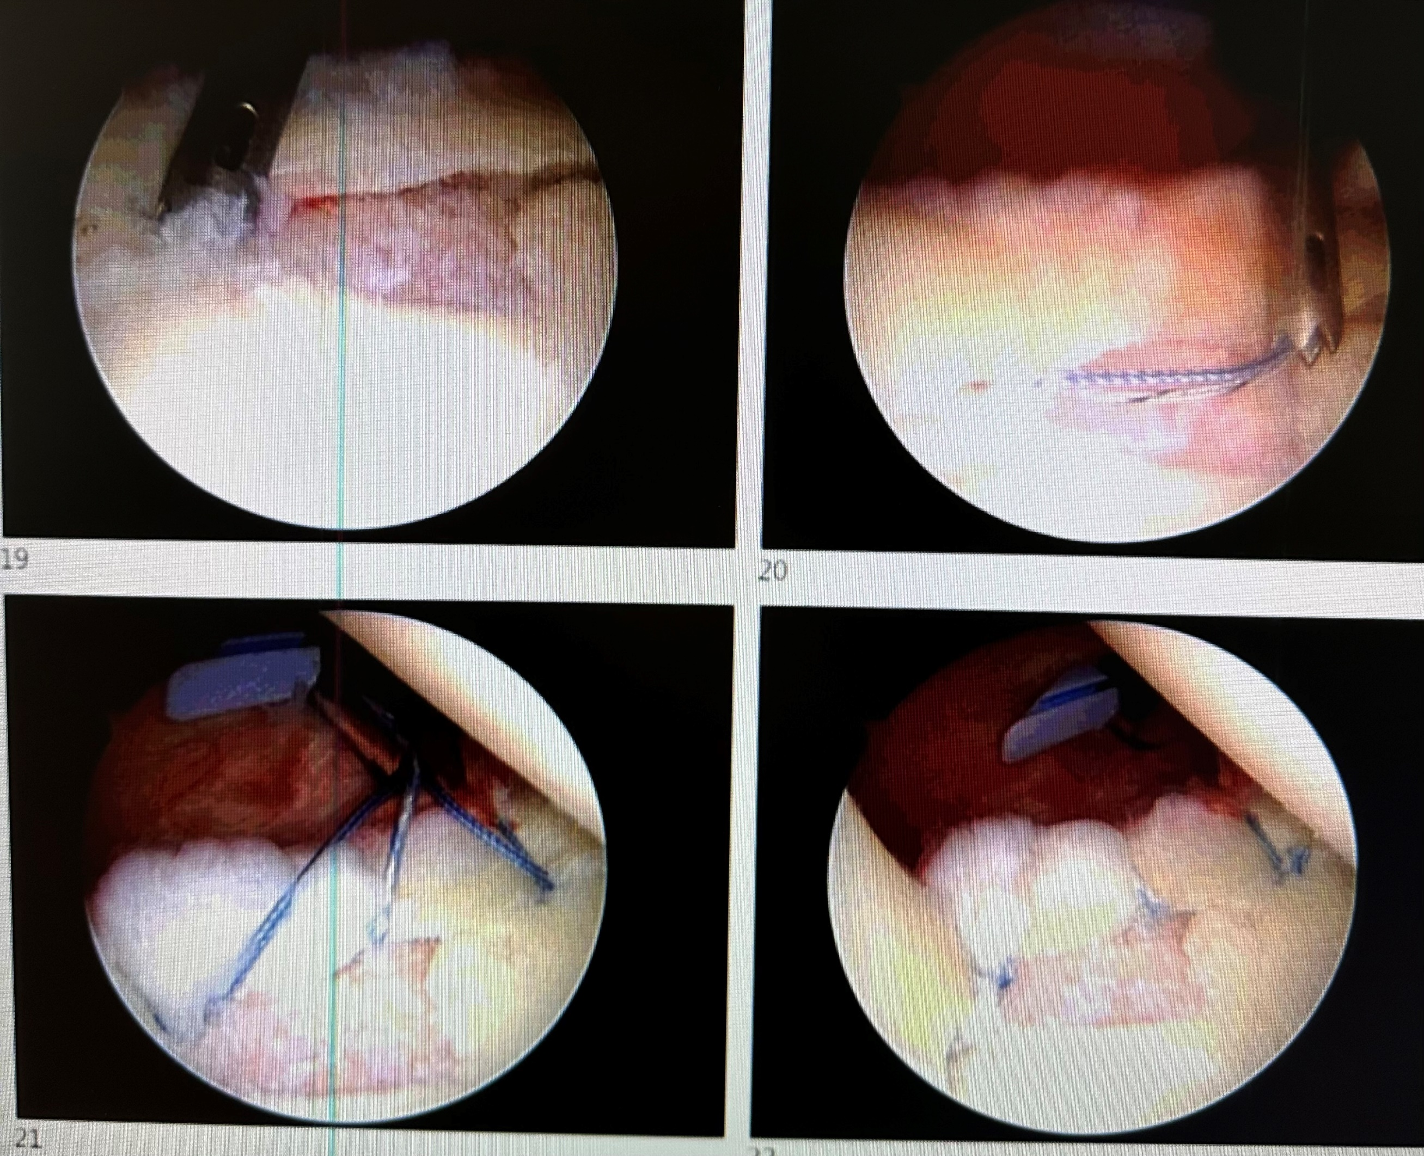
Isolated Slap repair

Slide 51
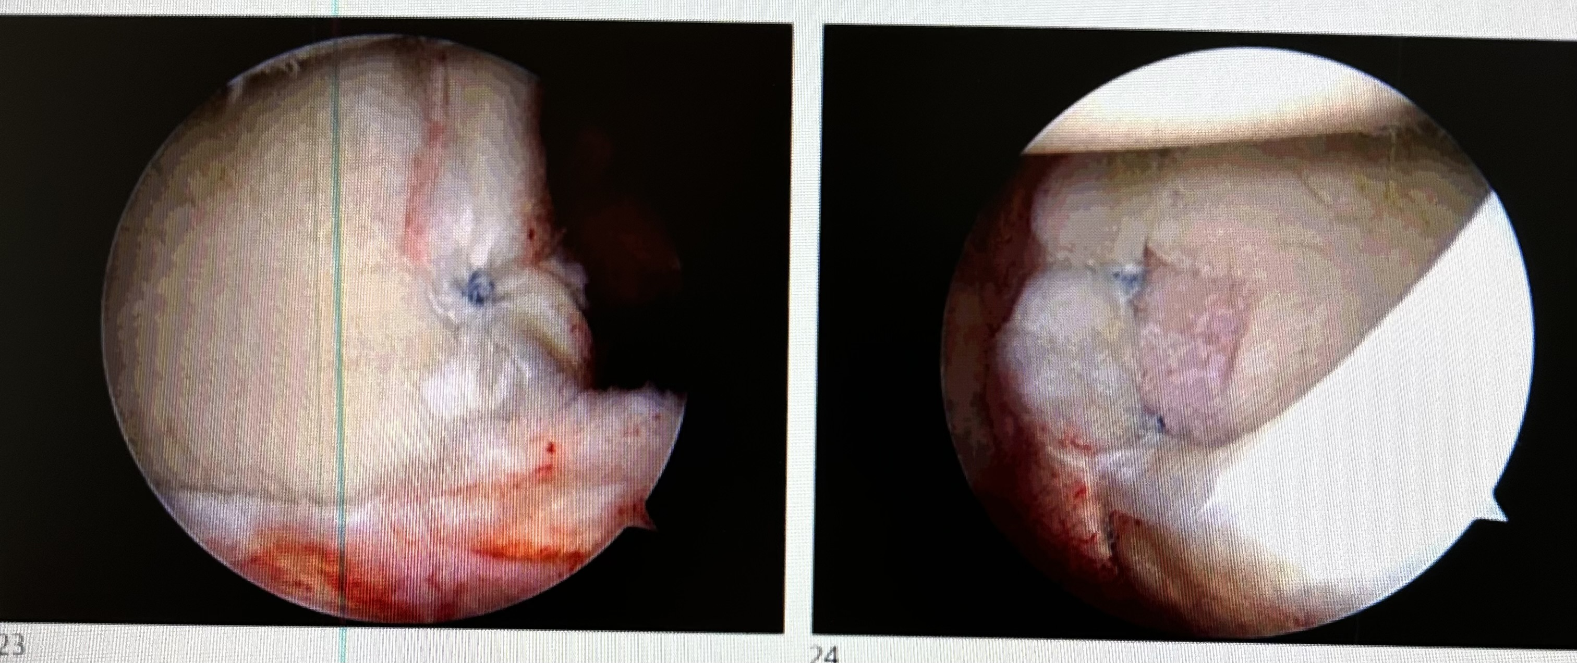
Isolated Slap repair

Slide 52
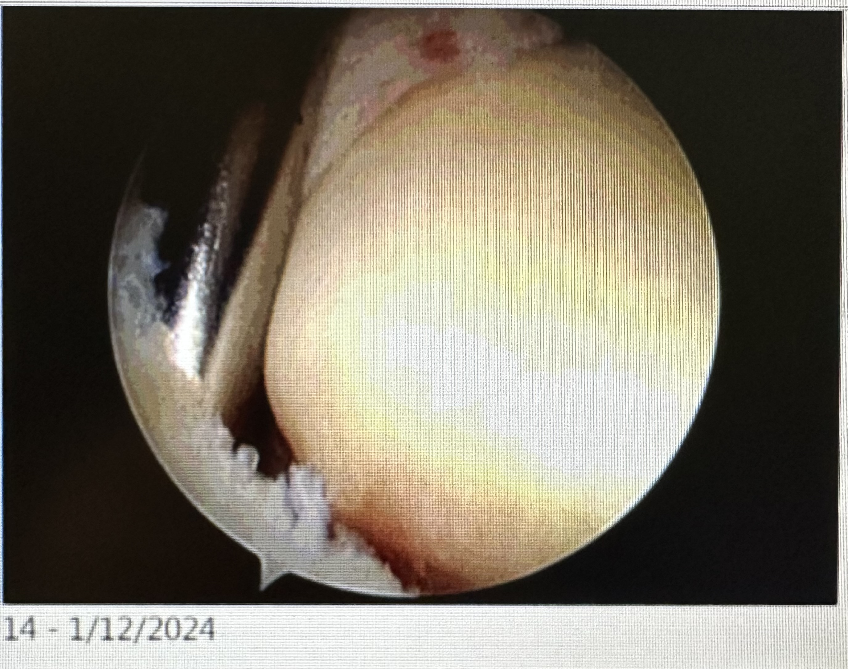
Tenodesis to treat slap

Slide 53
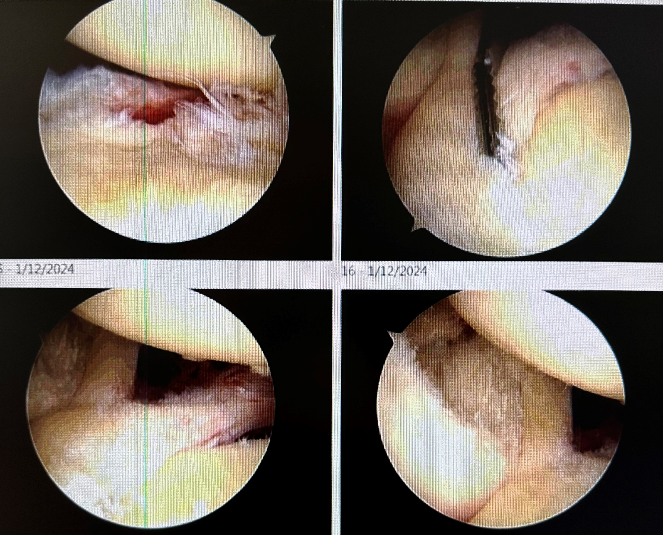
Tenodesis to treat slap

Slide 54
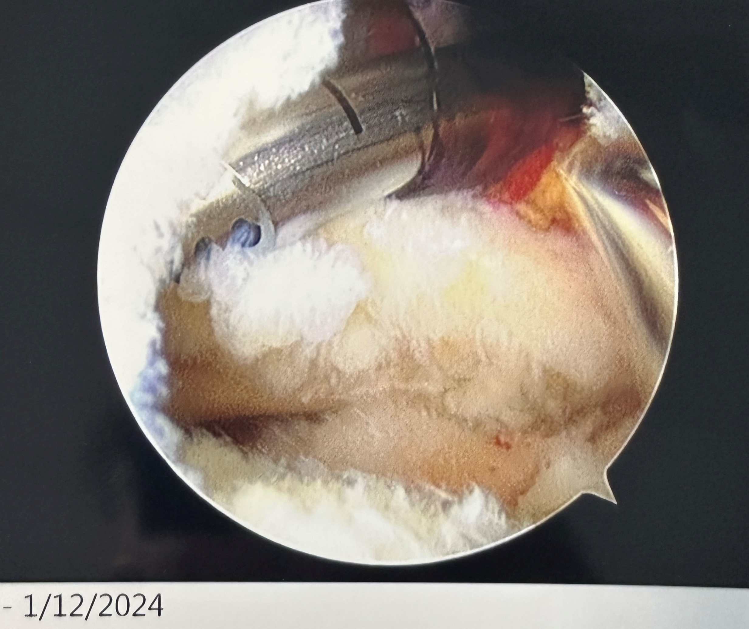
Tenodesis to treat slap

Slide 55
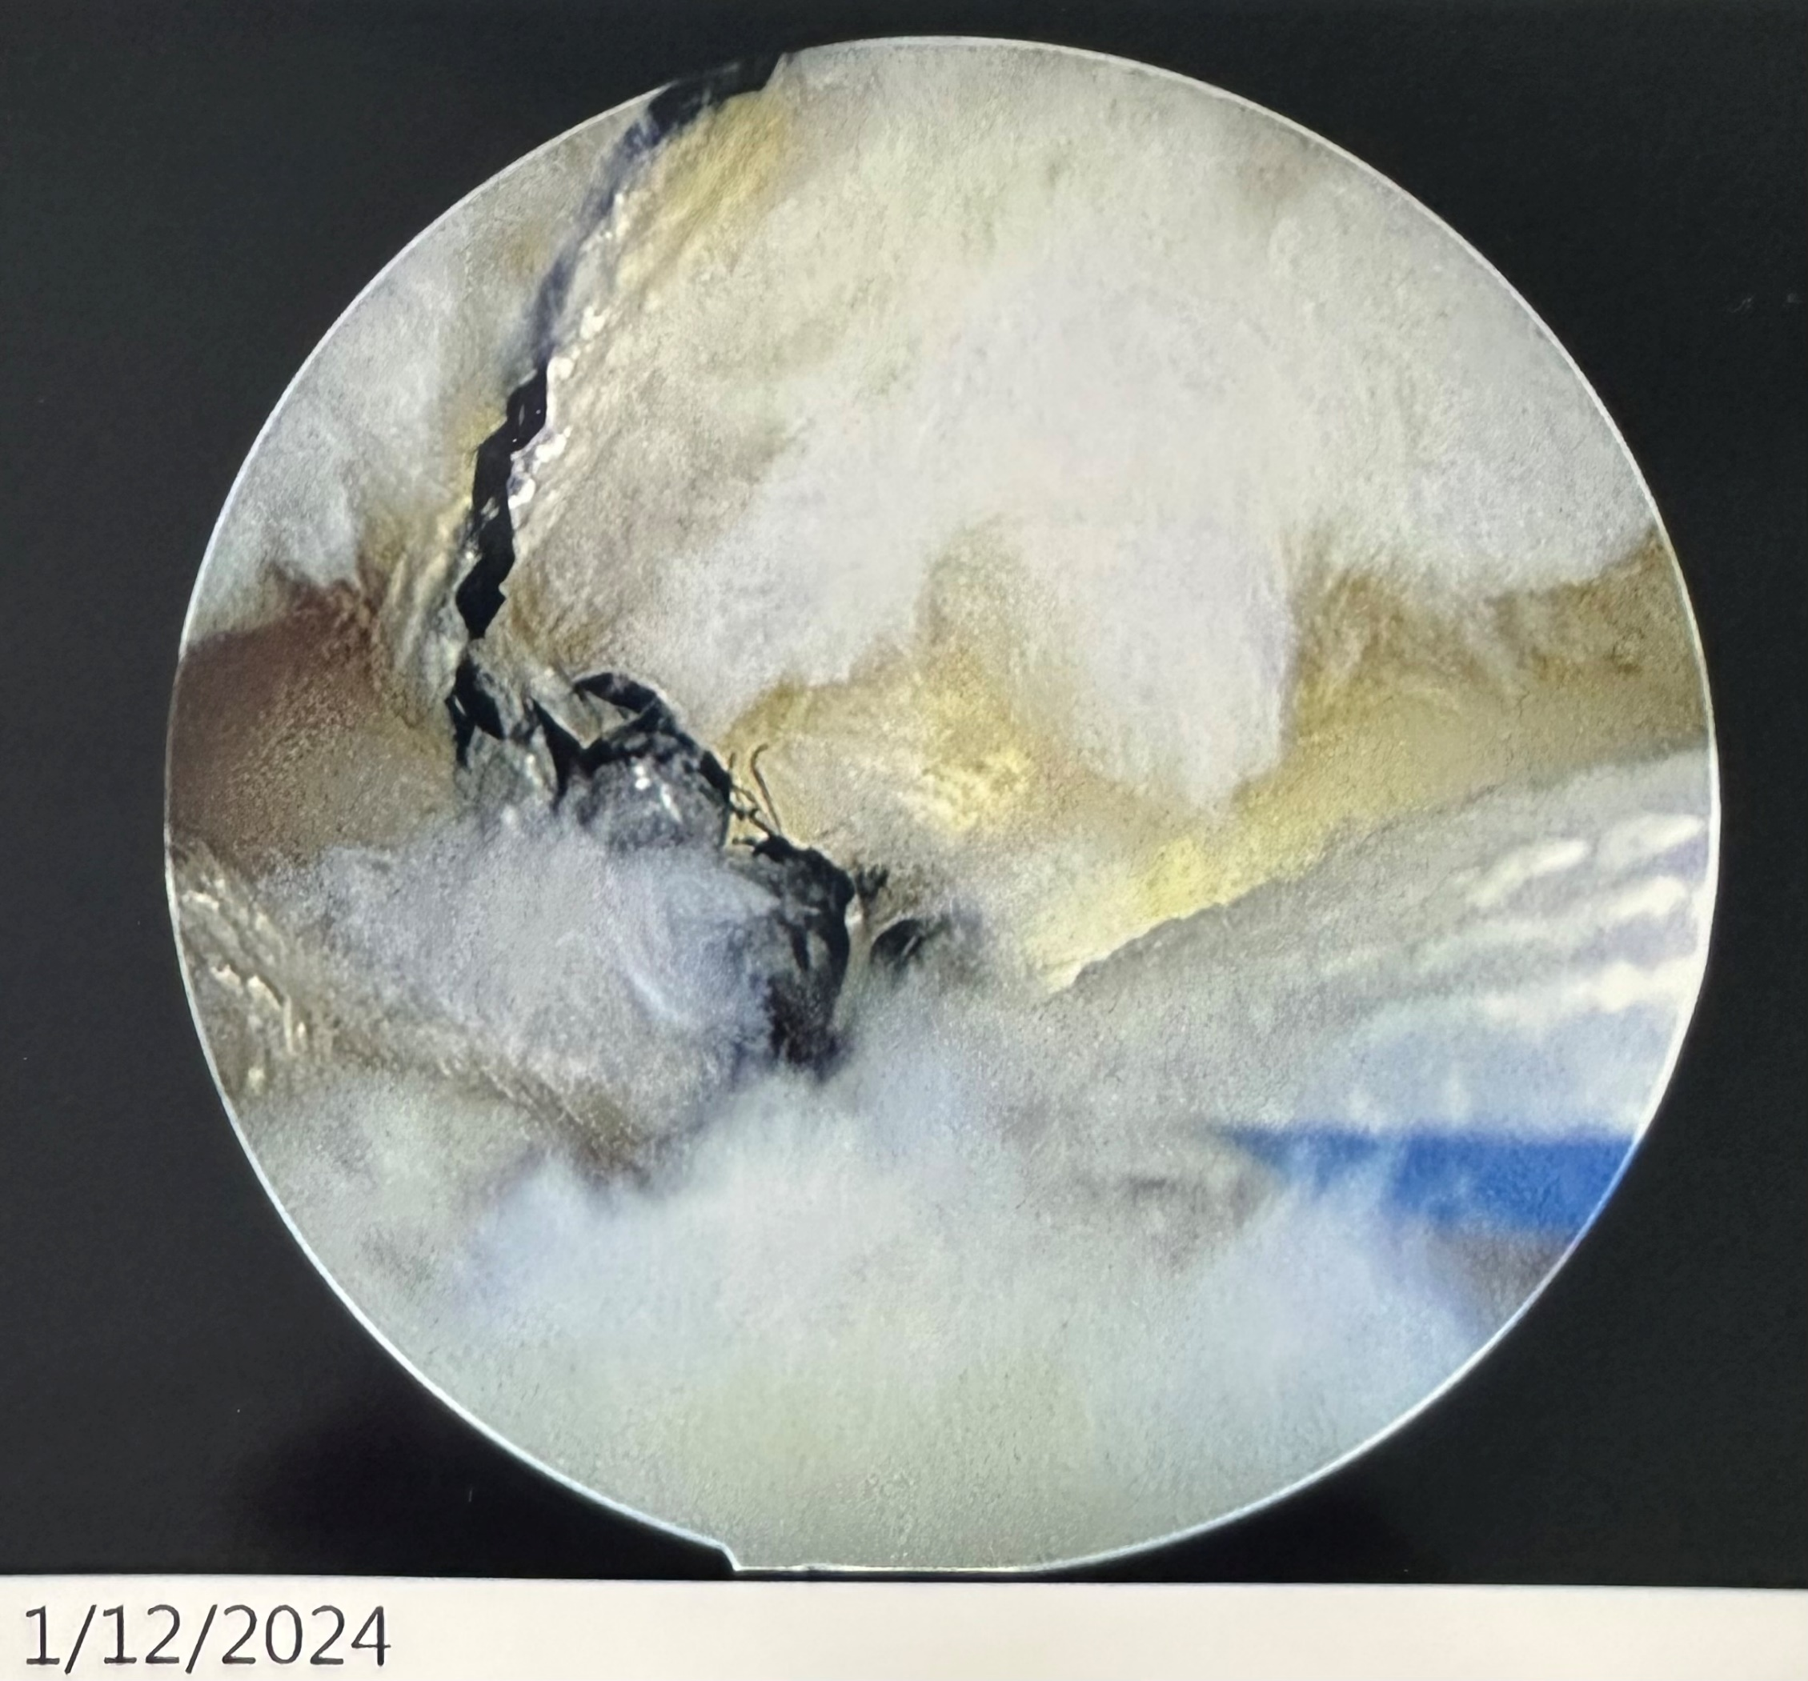
Tenodesis to treat slap

Slide 56
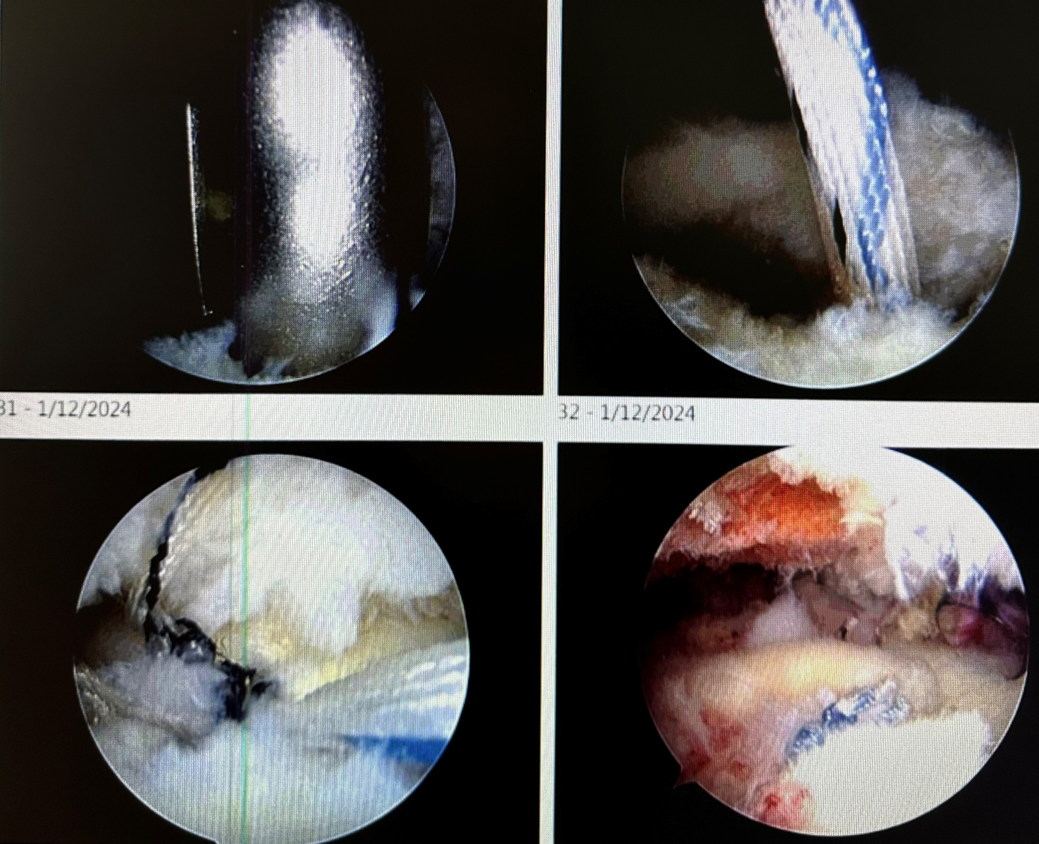
Tenodesis to treat slap

Slide 57
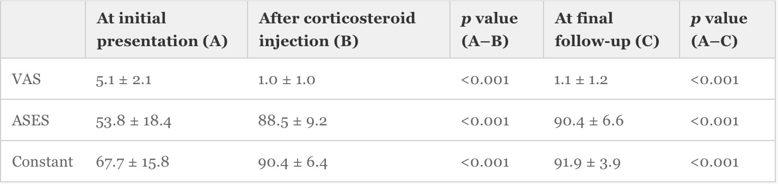
Outcomes
46 patients aged 30-45 w/ symptomatic SLAP and +MRI
39/46 (85%) successfully treated non-operatively
Shin, et al. 2016

Slide 58
Outcomes
86 patients w/ cuff tear and SLBC (biceps partial tears <50%, partial pulley lesions, type II SLAP)
Randomized to debridement, biceps tenotomy, biceps tenodesis
Pain, ROM, & functional scores improved in all groups
Risk of popeye deformity in tenotomy or tenodesis; tenotomy had less supination strength
Tenotomy for groove/tendon pain, tenodesis for preservation of strength
Oh, et al, 2016

Slide 59
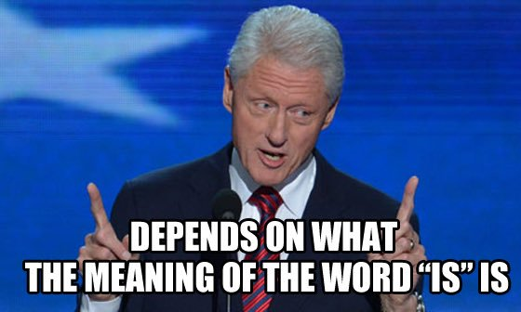
Controversies
Operations vs true incidence - Up to 35% MRIs but 3-25% in surgery. Of 544 scopes, 136 had SLAP (25%). 88% had other pathology (Kim, et al.)
When to operate on an isolated labral tear?
Where to perform tenodesis?

Slide 60
References
Powers, et al. Journal of the American Academy of Physician Assistants. Issue: Volume 24(3), March 2011, p 32–42
Burkhart SS, Morgan CD: The peel-back mechanism: Its role in producing and extending posterior type II SLAP lesions and its effect on SLAP repair rehabilitation. Arthroscopy 1998;14: 637-640
Burkhart SS, Morgan CD, Kibler WB: The disabled throwing shoulder: Spectrum of pathology. Part I: Pathoanatomy and biomechanics. Arthroscopy 2003;19:404-420.
RaoAG,KimTK, Chronopoulos E, McFarland EG: Anatomical variants in the anterosuperior aspect of the glenoid labrum: A statistical analysis of seventythree cases. J Bone Joint Surg Am 2003; 85:653-659
Lieberman, et al. AAOS Comprehensive Orthopaedic Review, 2014, ch 84
Weber, Steven. DeLee & Drez's Orthopaedic Sports Medicine, 4th edition, 2015, SLAP Tears, 543-549.e1
Patterson et al. Am J Sports Med. 2014 Aug;42(8):1904-10. doi: 10.1177/0363546514534939. Epub 2014 Jun 2
Brockmeyer, et al. Knee Surg Sports Traumatol Arthrosc (2016) 24:447–455
Shin, S., Lee, J., Jeon, Y. et al. Knee Surg Sports Traumatol Arthrosc (2016). doi:10.1007/s00167-016-4226-7
KimTK, Queale WS, Cosgarea AJ, McFarland EG: Clinical features of the different types of SLAP lesions: An analysis of one hundred and thirty-nine cases. J Bone Joint Surg Am 2003;85:6671.
Keener, et al. J AmAcad Orthop Surg 2009;17: 627-637
Oh et al. Arthroscopy. 2016 Jun; 32(6):958-67. doi: 10:1016/j.arthro 2015.11.036. Epub 2016 Feb 23

